Slide 1
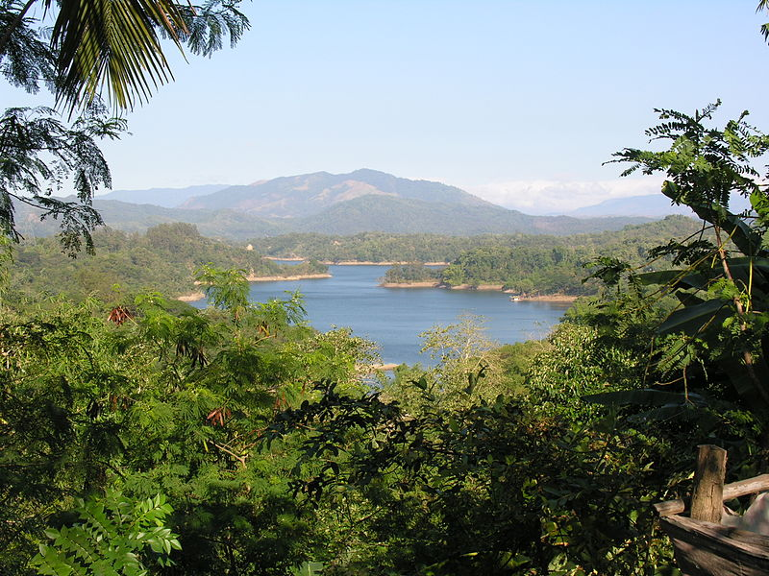
Pantabangan-Carranglan Watershed Forest Reserve
FOREST
MANAGEMENT
BUREAU
Harnessing forestry science for sustainable development
INTEGRATED WATERSHED MANAGEMENT
FOR. JERIC I. ANGELES
Forest Management Specialist I

Slide 2
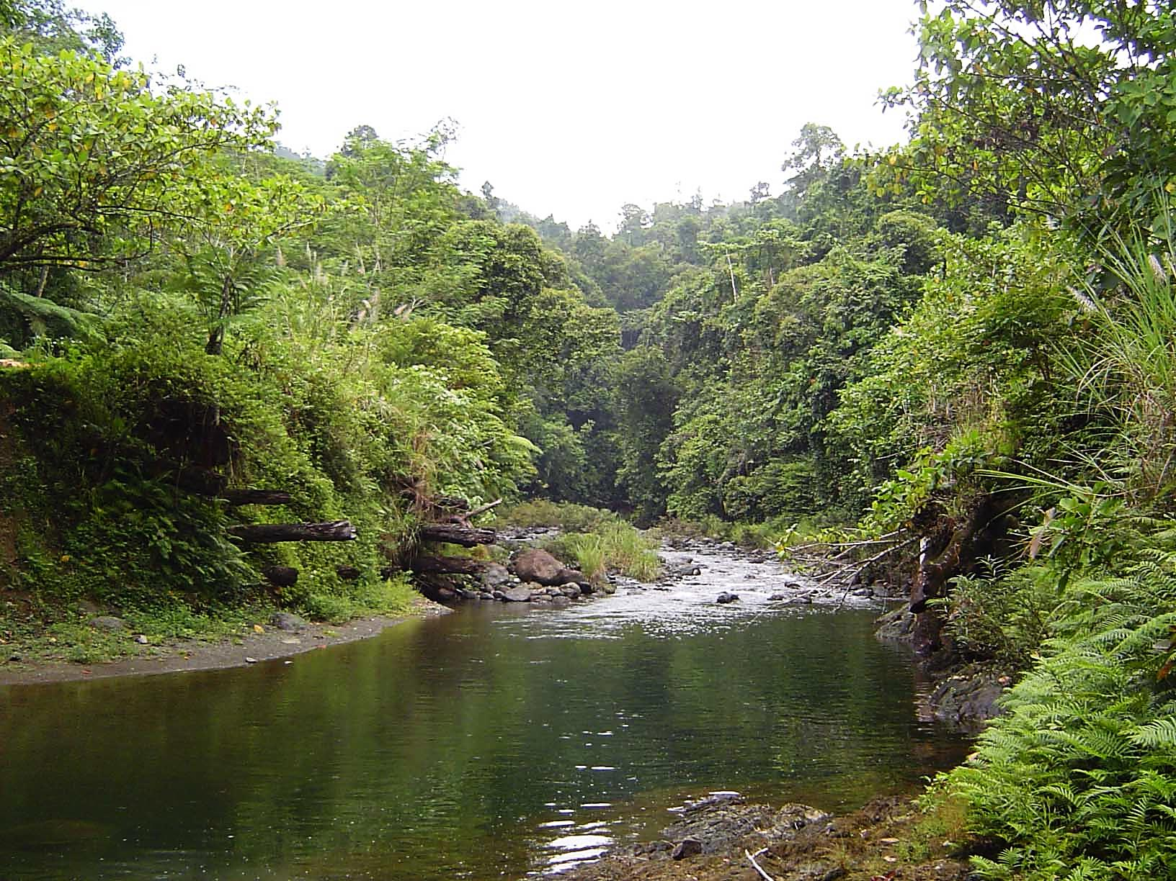
WATERSHED
A land area drained by a stream or any fixed body of water and its tributaries having a common outlet for surface run-off (PD 705).
Notes:
Under Presidential Decree No. 705, otherwise known as the Revised Forestry Code of the Philippines, watershed is defined as….

Slide 3
Drainage Area
Topographic Divide (Ridges)
Stream/fixed body of water
Common Outlet
(e.g. Lake)
WATERSHED COMPONENTS
Notes:
A watershed is composed of ….

Slide 4
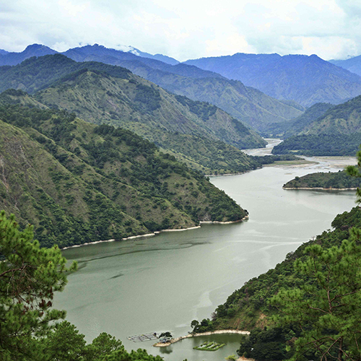
Ambuklao-Binga Watershed Forest Reserve, Atok, Bokod (Ambuklao-Binga Hydroelectric Power Plant)
CRITICAL WATERSHED
A drainage area of a river system supporting existing and proposed hydro-electric power and irrigation works needing immediate rehabilitation as it is being subjected to a fast denudation causing accelerated erosion and destructive floods. It is closed from logging until it is fully rehabilitated (PD 705).
Notes:
Under PD 705, a watershed can be classified as critical watershed. A critical watershed is defined as …..

Slide 5
Classification of Watersheds
Size | Area
Large | More than 1,000 km² (>100,000 ha)
Medium | 100 to 500 km² (10,000 – 50,000 ha)
Small | Less than 100 km² (<10,000 ha)

Slide 6
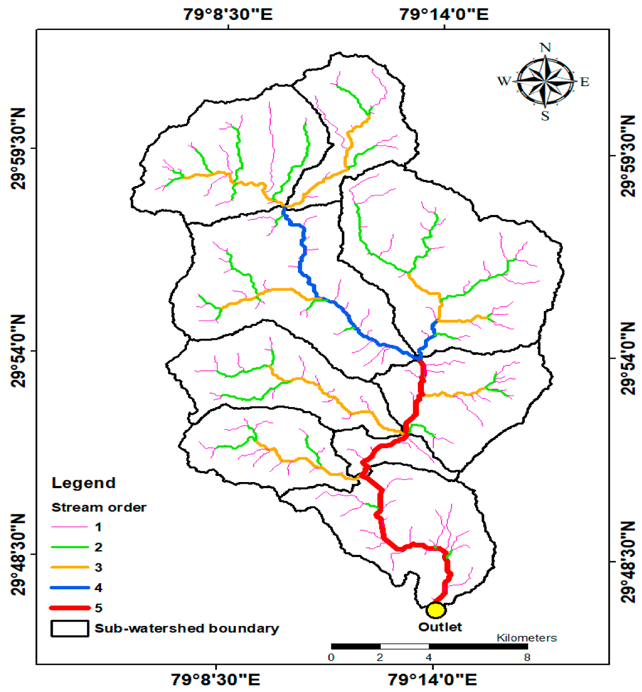
What is a subwatershed?
A watershed within a watershed
Notes:
a trench which was originally worn in the earth by running water and through which water often runs after rains

Slide 7
Watersheds in the Philippines
2,254 Ridge-to-Reef Watersheds
131 Priority Critical Watershed supporting NIA National Irrigation System (NIS)
113 Proclaimed Watershed Reservation
Notes:
In the country, watersheds are composed of ….

Slide 8
Legal Basis in the Integrated Watershed Planning and Management of the
Country’s Watersheds
DAO 99-1 “Adoption of the Watershed and Ecosystem Management Framework”
DMC 2008-05 “Guidelines in the Preparation of Integrated Watershed Management Plans”
Notes:
Way back in 2009, the DENR has already adopted the ridge to reef (Watershed Ecosystem Management Framework) approach in the preparation of watershed management plans. However, it was only in 2008, that the guidelines operationalizing the Watershed Ecosystem Framework was approved and it includes 3 components, namely, watershed characterization, vulnerability assessment and integrated watershed management planning.

Slide 9
Watershed Ecosystem Management (WEM) Framework
COASTAL
Ecosystem
zone
Ecosystem Based Approach
FOREST
Ecosystem
zone
URBAN
Ecosystem
zone
UPLAND
Ecosystem
zone
Tenure
Settlement
Settlement
Tenure
Protection
Production
Protection
Production
Protection
Production
Protection
Production
Social mobilization
Land uses and land use management
Integrated and interactive governance
Capacity Building and Institutional support partnership
Notes:
Under DAO 99-01, the Watershed Ecosystem Management (WEM) Framework is composed of four (4) ecosystems, namely, Forest Ecosystem , Upland Ecosystem, Urban Ecosystem and Coastal Ecosystem . The management approach of these ecosystems is governed by DAO 99-1, which adopts the holistic, multiple use and sustainable management of all the resources (soil, water, timber, and non-timber) found therein, including the management of people affected or living, within the different ecosystems of the watershed. DMC 2008-5 ensures that management of these ecosystems in the integrated watershed management plans are consistent with the Watershed and Ecosystem (WEM) Framework.

Slide 10
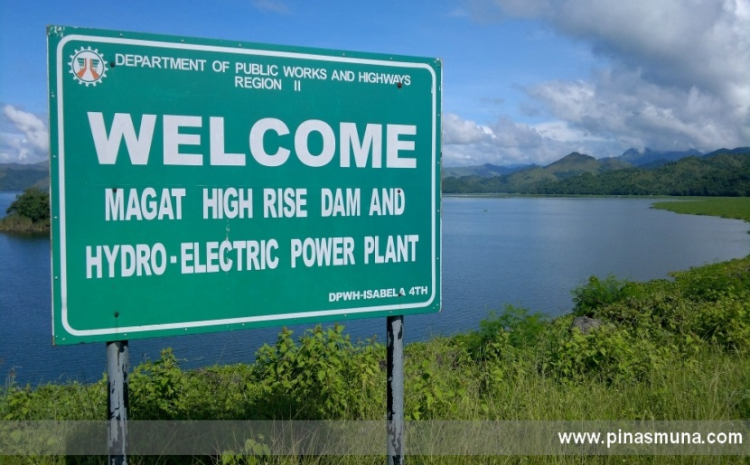
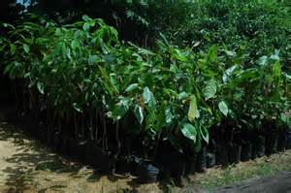
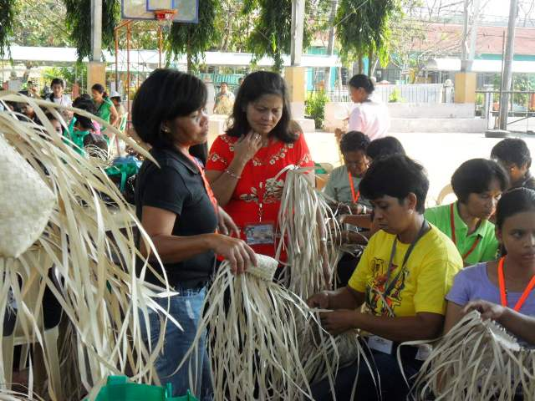
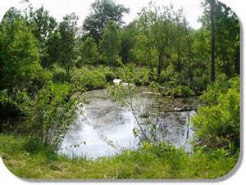
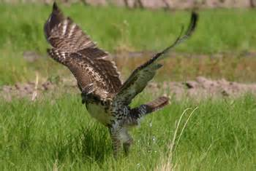
IMPORTANT USES OF WATERSHEDS
Vital sources of water supply
Socio-economic base/source of livelihood
Asset in the maintaining ecological balance of watershed resources
Notes:
The preparation of integrated watershed management plans considers the compatibility and sustainability of the various and often conflicting multiple uses of the watersheds and maintenance of the ecological integrity of the watershed. Thus, in the preparation of integrated watershed management plans, the following basic functions of the watershed should be prioritized , namely, watershed as:

Slide 11
Basic Objectives of Watershed Management
Improve care and management of the natural resources for economically productive purposes

Slide 12
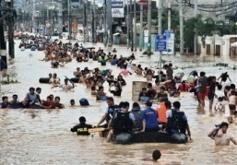
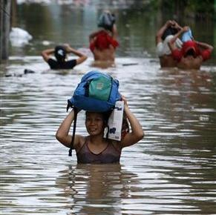
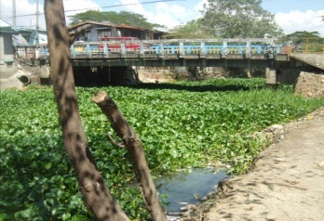
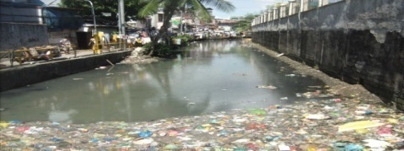
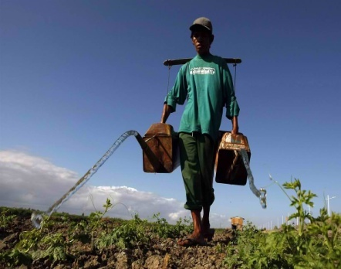
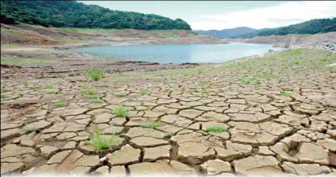
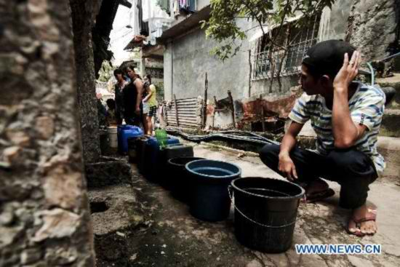
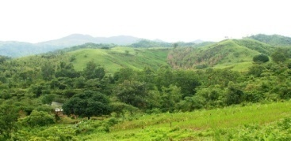
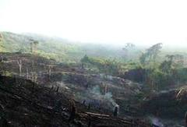
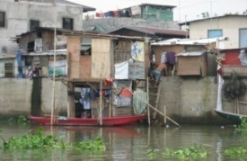
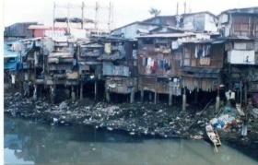
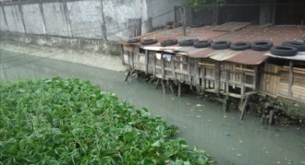
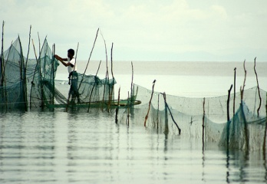
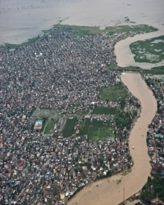
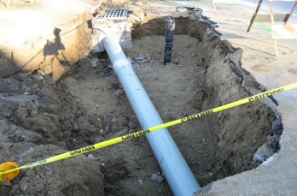
MAJOR ENVRONMENTAL ISSUES CONFRONTING THE COUNTRY’S RIVER BASINS AND WATERSHEDS
FLOODING
Water Pollution from Point and Non-Point Sources
DROUGHT
Forest Denudation
Informal
Settlers
Proliferation of Illegal fishpens/cages
Siltation and sedimentation
Over-extraction
of Groundwater
Poor Solid Waste Management
Weak Governance
Biodiversity Loss
SOURCE: RIVER BASIN CONTROL OFFICE
Notes:
The preparation of an integrated watershed management plan also considers the existing problems in a watershed. In order to determine the interventions needed by a particular watershed. Generally, these are the typical issues and problems confronting the country’s watersheds. From denudation of the watersheds, siltation and sedimentations of rivers which aggravated by changing climate resulted to the natural disasters due to flooding, drought and landslides. Increasing population and rapid urbanization causes the degradation of water quality both surface and groundwater. Proliferation of informal settlers and illegal fishpens/cages also affects water quality of our lakes and marshes. In general, the result is greater loss of biodiversity in whole ecosystem. Also, the weak governance resulted to fragmented planning, management and non-sustainability of investment for development and rehabilitation.

Slide 13
Picture Source: ERDS R-4A (CALABARZON)
Notes:
One of the important features of DMC 2008-05 is the incorporation of vulnerability assessment which can be used in the prioritization of activities to be funded as budget for watershed activities is limited.

Slide 14
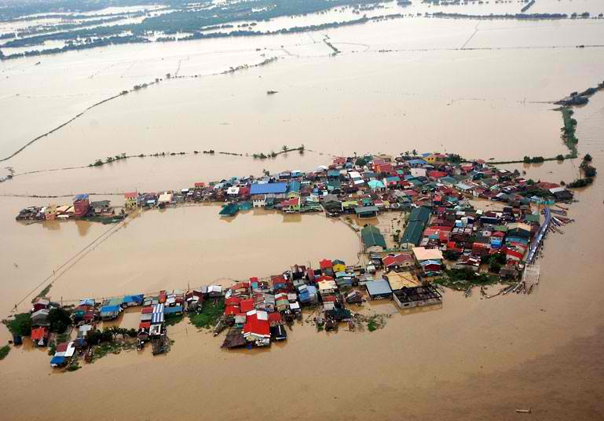
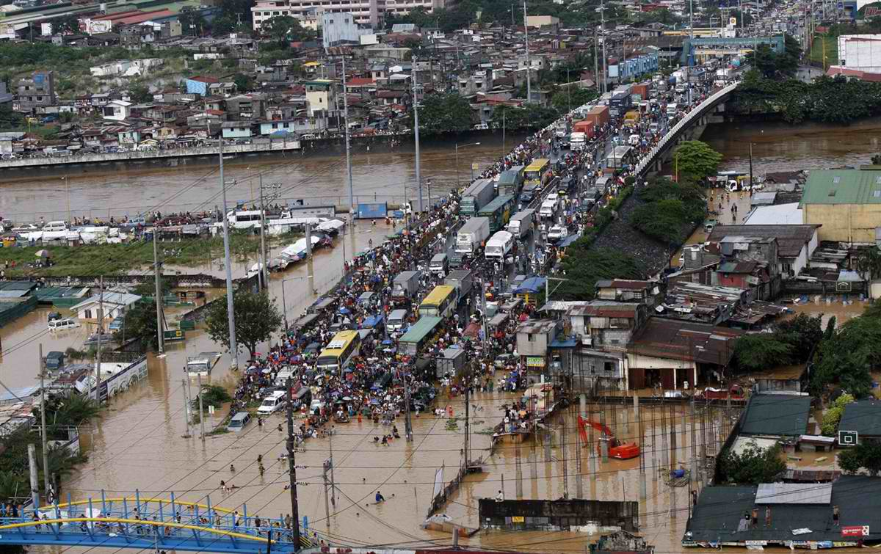
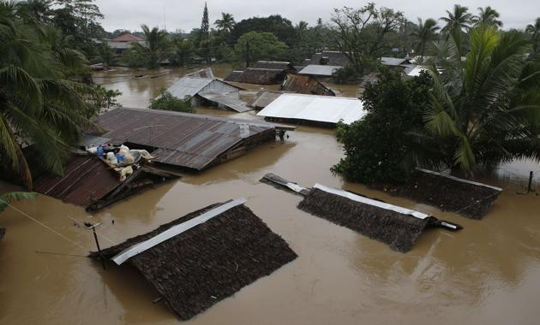
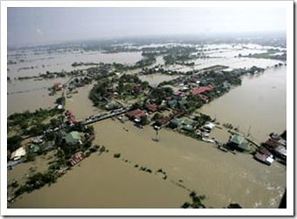
Swollen Rivers and Creeks
Bulacan Province
Marikina River
Tacloban City
Pampanga River
Notes:
These are just some of the current disasters that affected the downstream portions of our watersheds.

Slide 15
INTEGRATED WATERSHED PLANNING AND MANAGEMENT
National Gov't. Agencies (multi-agencies) -National Programs
Environmental Groups
Agricultural Interest Groups
Communities, POs, LGUs, etc
Regional Offices (Multi-sectoral & multidisciplinary) – Regional Programs
Other Sector interest Groups
Local Watershed
Initiative -
Community Lead
Watershed Planning and
Management
Local Organizations
Indigenous Peoples Programs
Notes:
DMC 2008-05 recognizes that the stakeholders of the watershed are multidisciplinary, multi-sectoral and varied. Hence, for a plan to be sustainable and effective, Integrated Watershed Management Planning should be demand driven and lead by the local communities (e.g. Watershed communities, POs, and LGUs) and supported by the National Government Agencies, Regional offices and other agencies with policies and technical support and assistance.

Slide 16
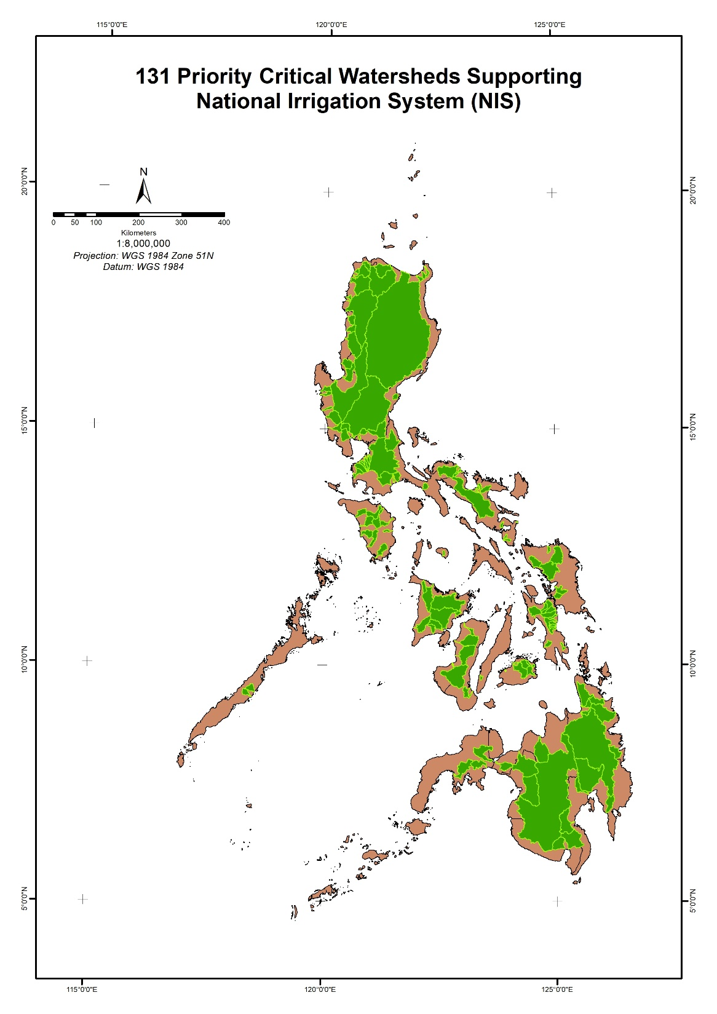
131 Priority Critical Watersheds Supporting National Irrigation System (NIS)
Notes:
As seen in the map, the 143 priority critical watersheds are distributed all throughout the country.

Slide 17
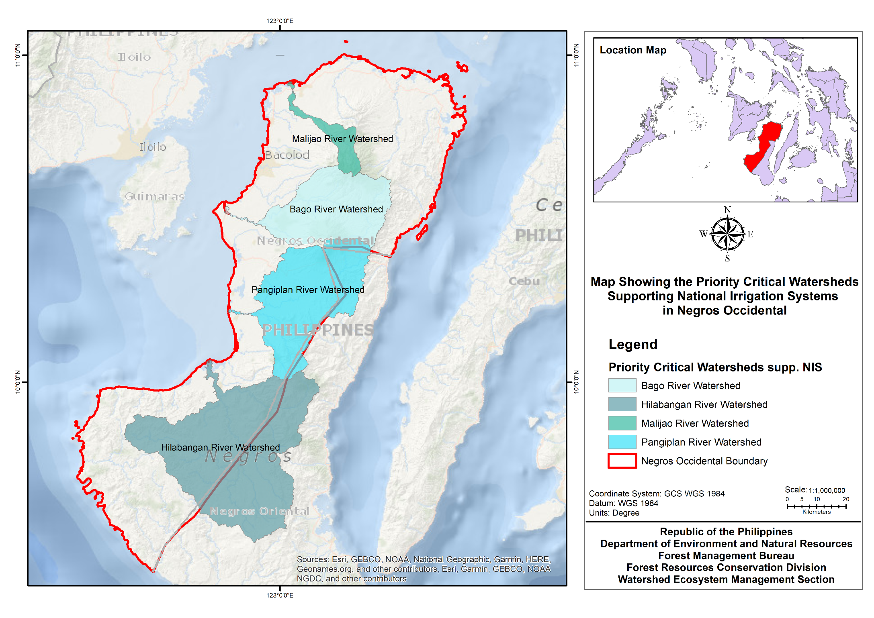

Slide 18
List of Priority Critical Watersheds supporting National Irrigation Systems in Negros Occidental
Watershed | Area Based on Ridge to Reef (ha) | Lead Region | Concerned Regions | Provinces | Municipalities | Watersheds Covered within the 143 Priority Critical Watersheds Supporting NIS | Area covered per Region (ha)
Pangiplan River Watershed | 106,487 | Region 6 | Region 6 | Negros Occidental | Binalbagan, Himamaylan City, Hinigaran, Isabela, La Carlota City, La Castellana, Moises Padilla, Murcia, Pontevedra, San Carlos City | Pangiplan River Watershed | 83,629
 |  |  | Region 7 | Negros Oriental | Canlaon City, Guihulngan City, Jimalalud, La Libertad, Tayasan, Vallehermoso |  | 22,857
Bago River Watershed | 81,120 | Region 6 | Region 6 | Negros Occidental | Bago City, Calatrava, La Carlota City, Murcia, Pulupandan, Salvador Benedicto, San Carlos City, Talisay City | Bago River Watershed | 81,120

Slide 19
List of Priority Critical Watersheds supporting National Irrigation Systems in Negros Occidental
Watershed | Area Based on Ridge to Reef (ha) | Lead Region | Concerned Regions | Provinces | Municipalities | Watersheds Covered within the 143 Priority Critical Watersheds Supporting NIS | Area covered per Region (ha)
Hilabangan River Watershed | 198,764.44 | Region 6 | Region 6 | Negros Occidental | Candoni, Cauayan, Himamaylan City, Ilog, Kabankalan City, Sipalay City |  | 106,449.05
 |  |  | Region 7 | Negros Oriental | Ayungon, Bais City, Bayawan City, Bindoy, Jimalalud, Mabinay, Manjuyod, Tanjay City, Tayasan |  | 92,312.39
Malijao River Watershed | 16,001.69 | Region 6 | Region 6 | Negros Occidental | Cadiz City, Calatrava, Enrique B. Magalona, Salvador Benedicto, Silay City, Talisay City, Victorias City |  | 16,001.69

Slide 20
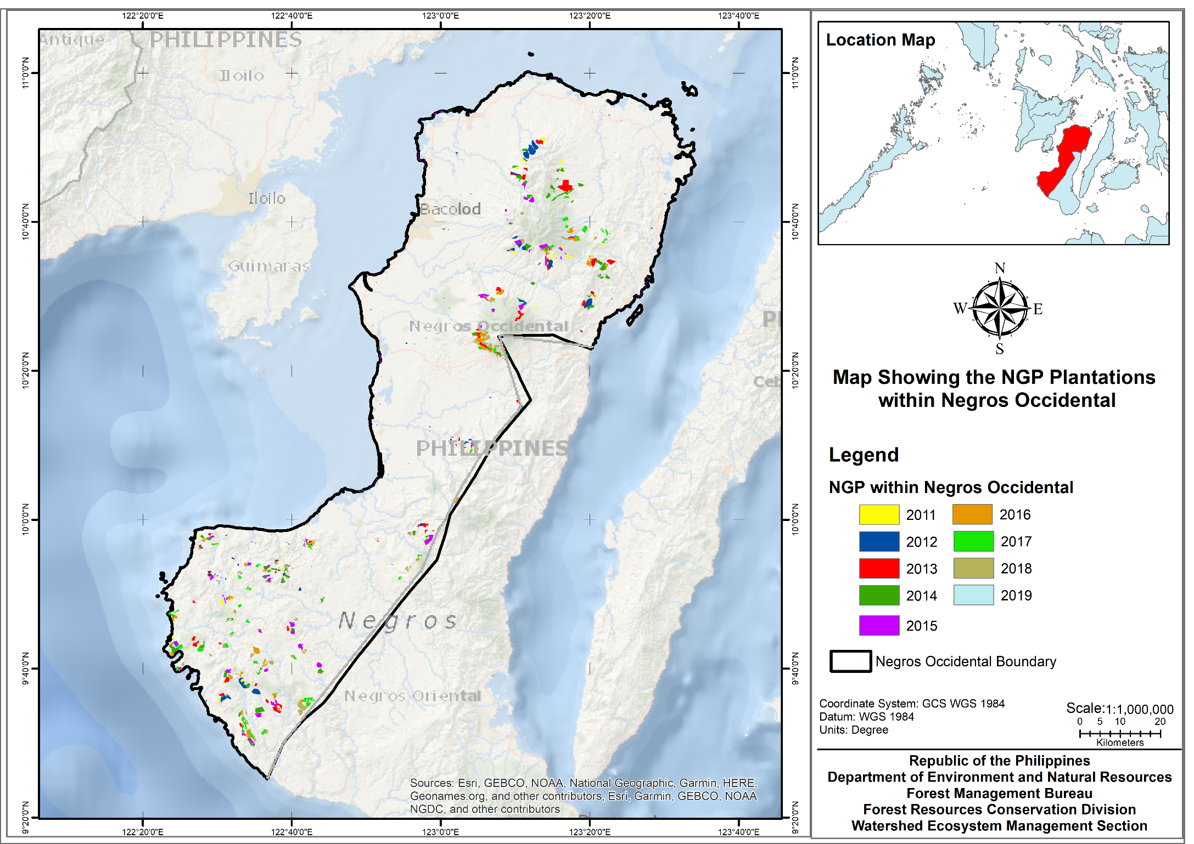
Area Developed: 1,183,871 hectares

Slide 21
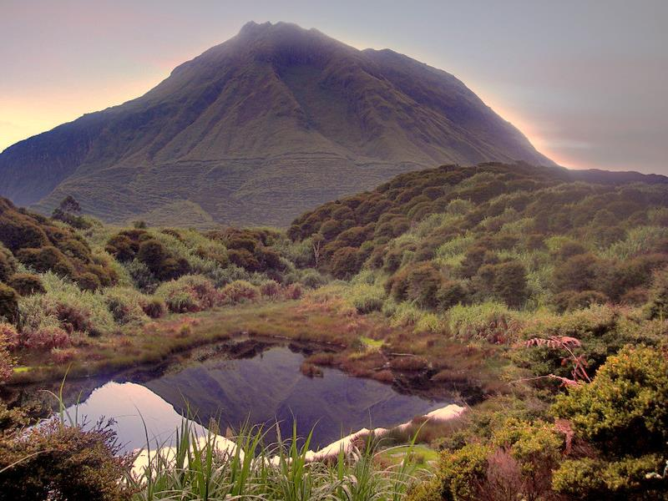
“Everyone lives in a Watershed, your own backyard is part of Watershed ”
Thank You!
FOREST
MANAGEMENT
BUREAU
Harnessing forestry science for sustainable development

